Slide 1
Novel positional encodings to enable tree-based transformers
Vighnesh Leonardo Shiv Chris Quirk
Reporter: 李泳民

Slide 2
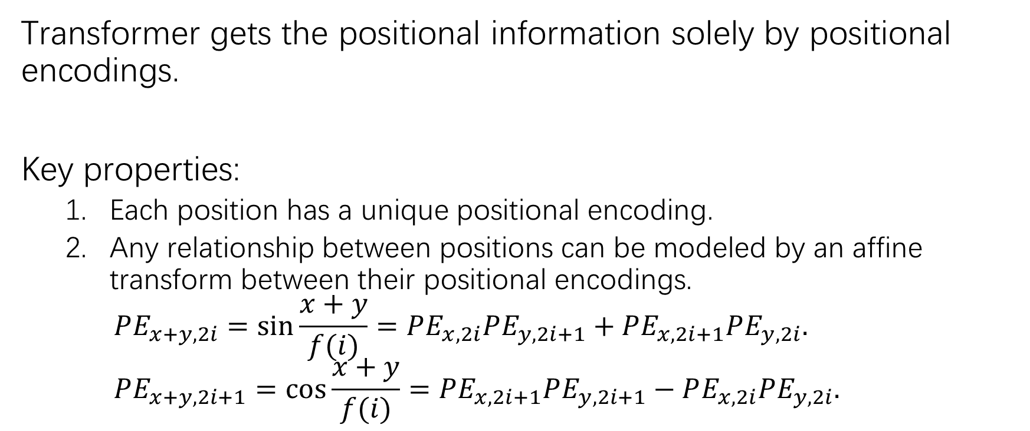
Positional encodings in attention models
Transformer gets the positional information solely by positional encodings.
Key properties:
Each position has a unique positional encoding.
Any relationship between positions can be modeled by an affine transform between their positional encodings. $PE_{x+y, 2i}=\sin{\frac{x+y}{f(i)}}=PE_{x, 2i}PE_{y, 2i+1}+PE_{x, 2i+1}PE_{y, 2i}.$ $PE_{x+y, 2i+1}=\cos{\frac{x+y}{f(i)}}=PE_{x, 2i+1}PE_{y, 2i+1}−PE_{x, 2i}PE_{y, 2i}.$

Slide 3
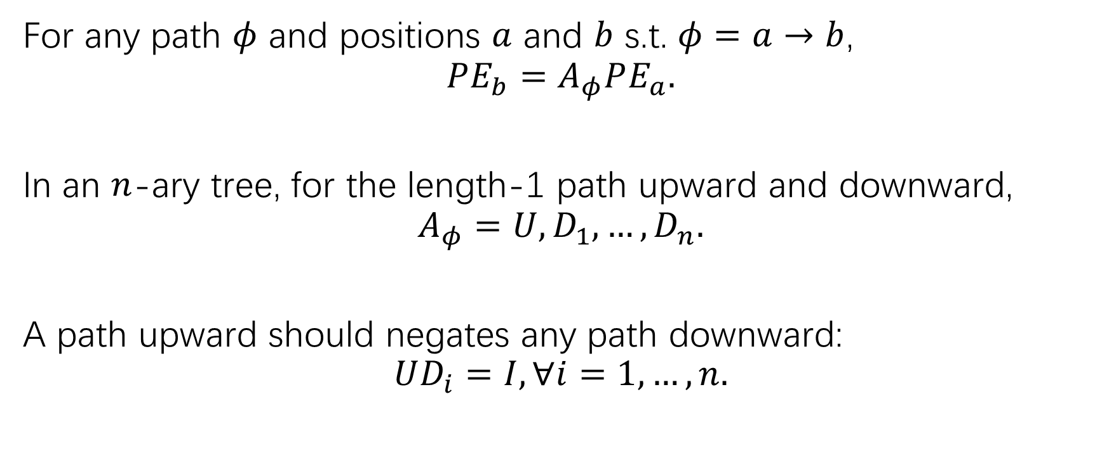
Tree positional encodings
For any path $φ$ and positions $a$ and $b$ s.t. $φ=a→b$, $$PE_{b}=A_{φ}PE_{a}.$$
In an $n$-ary tree, for the length-1 path upward and downward, $$A_{φ}=U, D_{1}, …, D_{n}.$$
A path upward should negates any path downward: $$UD_{i}=I, ∀i=1, …, n.$$

Slide 4

Tree positional encodings
Each positional encoding has dim $nk$, and after $k$ layers, it will forget original information. $$x=D_{b_{L}}…D_{1}0.$$

Slide 5
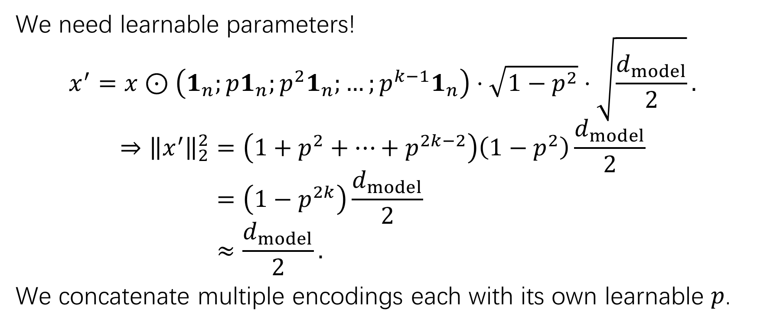
Tree positional encodings
We need learnable parameters!
$$x^{′}=x⊙\left(1_{n};p1_{n};p^{2}1_{n};…;p^{k−1}1_{n}\right)⋅\sqrt{1−p^{2}}⋅\sqrt{\frac{d_{model}}{2}}.$$
$$⇒{\left\|x^{′}\right\|}_{2}^{2}=\left(1+p^{2}+…+p^{2k−2}\right)\left(1−p^{2}\right)\frac{d_{model}}{2} \\ =\left(1−p^{2k}\right)\frac{d_{model}}{2} \\ ≈\frac{d_{model}}{2}.$$
We concatenate multiple encodings each with its own learnable $p$.

Slide 6
Decoder
We should use appropriate positional encoding for each autoregressed output.
Decoder should keep track of the partial tree structure.
In our experiments, we explored both DFS and BFS for decoding.

Slide 7
Experiments and results
Tree-to-tree tasks: Program translation
Sequence-to-tree tasks: Semantic parsing
For2Lam.
CoffeeScript to JavaScript.
JavaScript to CoffeeScript.
Jobs.
Geo.
Atis.

Slide 8
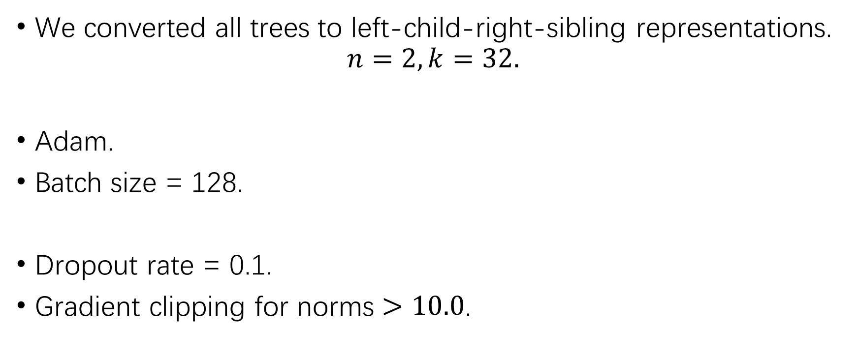
Experiments and results
We converted all trees to left-child-right-sibling representations.
$$n=2, k=32.$$
Adam.
Batch size = 128.
Dropout rate = 0.1.
Gradient clipping for norms $>10.0$.

Slide 9
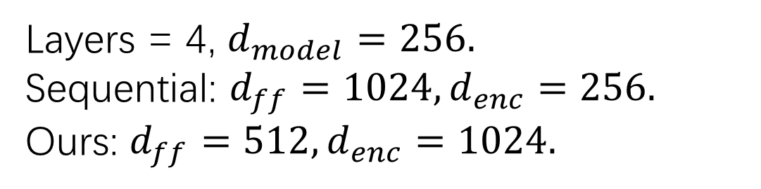
For2Lam
Layers = 4, $d_{model}=256.$
Sequential: $d_{ff}=1024, d_{enc}=256.$
Ours: $d_{ff}=512, d_{enc}=1024.$

Slide 10
CoffeeScript-JavaScript translation
Batch size=64 for longer sequences.

Slide 11
Sequence to Tree
Jobs: train size=500, test size=140.
Geo: train size=680, test size=200.
Atis: train size=4480, test size=450.
$$d_{model}=256, d_{ff}=1024, d_{pos}=2048$$

Slide 12
Conclusion
A novel custom positional encodings to extend transformers to tree-domain tasks.

Slide 13
Thank you!

